Slide 1


Optimizing Customer Response Prediction in Bank Marketing Campaigns
🔹 Case Study Title 🔹
"Optimizing Customer Response Prediction in Bank Marketing Campaigns"
🔹 Participants 🔹
1. Harsh Gangurde
📞 8530354735 | ✉️ harshgangurde077@gmail.com
2. Aditi Janwade
📞 9028244195 | ✉️ janwadeaditi@gmail.com

Slide 2


Problem Statement
Approach
Data Preprocessing
Label Encoding for categorical variables.
New features like balance-to-age ratio, duration × campaign interaction, and log transformation for skewed distributions.
Optimizing Customer Response Prediction in Bank Marketing Campaigns.
A leading financial institution conducts periodic marketing campaigns to promote term deposit subscriptions. Despite generating leads, the conversion rate remains low, leading to inefficient resource allocation and missed revenue opportunities. The objective is to identify key factors influencing customer responses to enhance targeting strategies and improve conversion rates.
2.Feature Engineering
Hyperparameter tuning: Optuna optimizes XGBoost parameters using Stratified K-Fold cross-validation.
Training multiple models: XGBoost, LightGBM, and CatBoost classifiers trained with class imbalance handling.
3.Model Training
Weighted averaging of predictions from XGBoost, LightGBM, and CatBoost.
Classification threshold optimized using F1-score maximization.
4.Model Evaluation & Ensemble Learning
Test predictions generated with an optimized threshold.

Slide 3

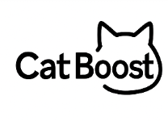


| Framework
Data Preprocessing
Feature Engineering
Model Training
Model Evaluation & Ensemble Learning
01
02
03
04
Label Encoding
Duration × Campaign Interaction
Hyperparameter Tuning
Precision
XGBoost, LightGBM, CatBoost
F1-score
Exploratory Data Analysis (EDA)
Balance-to-Age Ratio
Accuracy
Log Transformation
Class Imbalance Handling
Recall

Slide 4



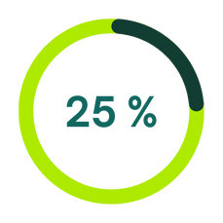


| Customer Satisfaction.
Customer Demographics & Behavior
Age Trends: Younger, middle-aged customers showed higher engagement than older groups.
Job Influence: Roles like technicians and management had higher positive response rates.
Marital Status: Single individuals responded more than married or divorced customers.
Education Level: Customers with tertiary education were slightly more likely to respond positively.
Previous Campaign Interactions
Customers: Previously contacted and had positive outcomes (poutcome = success) show a significantly higher response rate. Those with no prior contact or unsuccessful outcomes (poutcome = failure) are less likely to engage again.
Strong behavioral pattern: Indicating trust or loyalty from previously contacted customers.

Slide 5


| Customer Satisfaction.
Communication Channels & Timing
Cellular contact: Highest response rate, outperforming telephone and unknown methods.
Engagement: May, June, and August are high-performing months with increased customer.
Mid-week day: Tuesday and Thursday tend to show better response behavior compared to weekends or Mondays.
Financial & Economic Indicators
Customers : Higher account balances have a notably higher response rate.
Strong behavioral pattern: Indicating trust or loyalty from previously contacted customers.

Slide 6
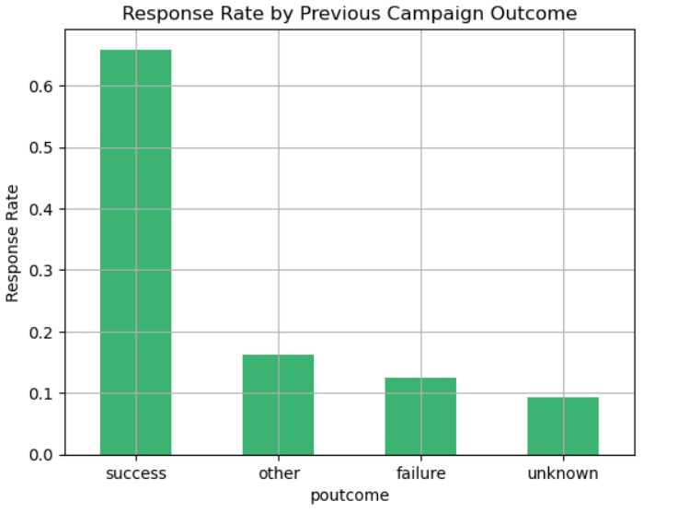
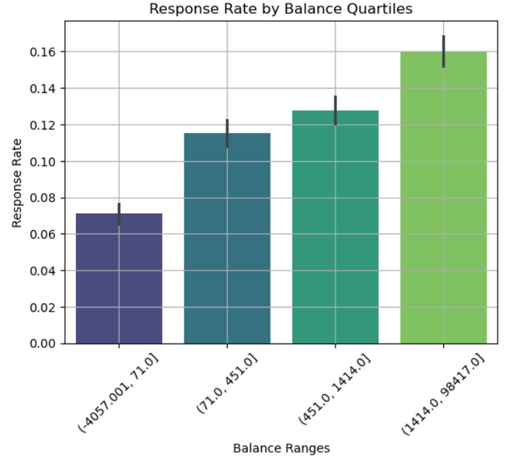
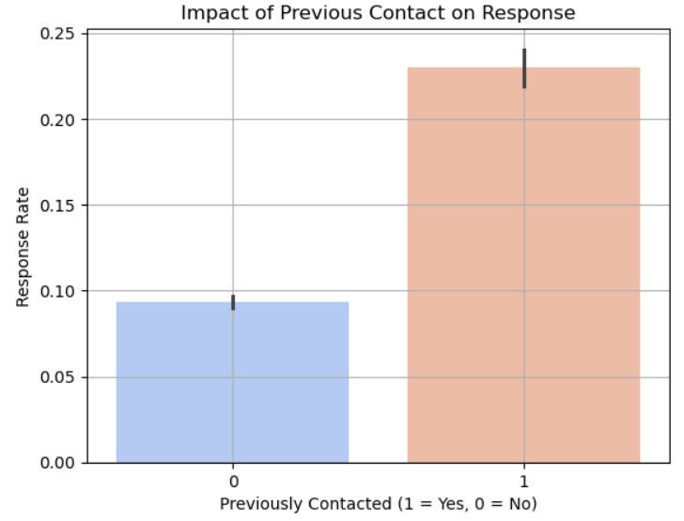
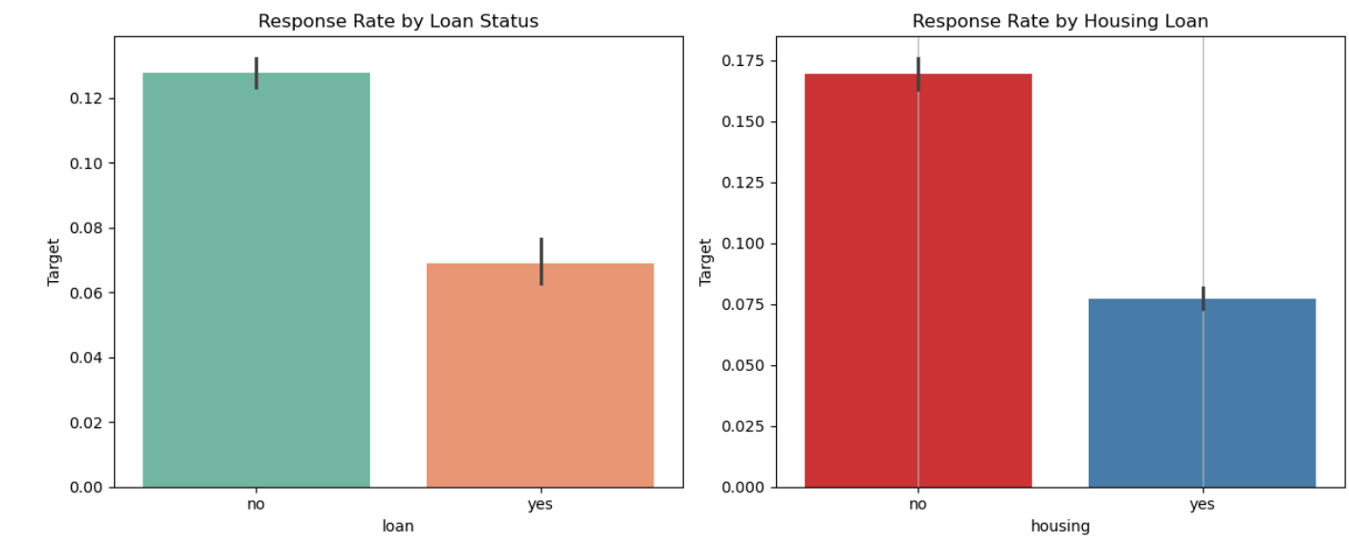
Not a Person
but Numbers
speaks...

Slide 7
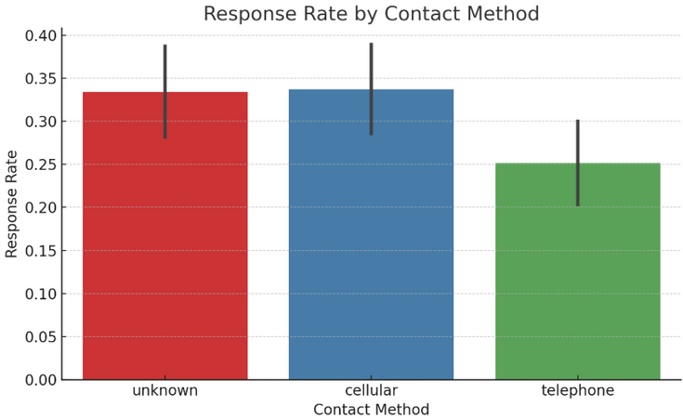
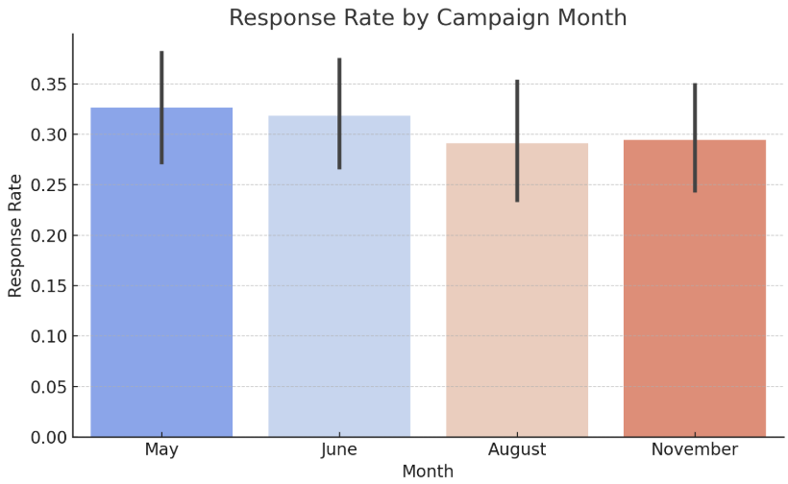
| Business Recommendations
1.Optimize Communication Channels.
Use cellular contact methods over telephone or unknown sources to maximize response rates.
2.Target High-Value Segments.
Focus outreach on customers with higher balances, no active loans, and past successful interactions — they are most likely to convert.
3.Timing Matters.
Schedule campaigns during May, June, and August, especially mid-week (like Tuesdays and Thursdays) for better engagement.

Slide 8


Thank You

